Slide 1
Conformal Field Theory
LEE SungBin

Slide 2
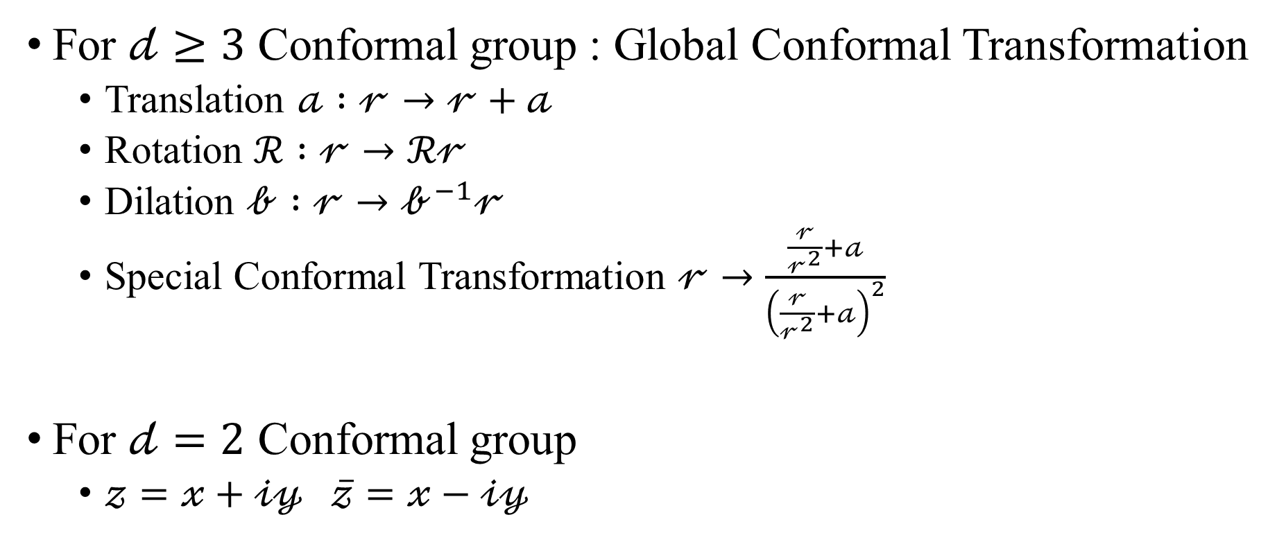
Conformal Transformation
For $𝒹≥3$ Conformal group : Global Conformal Transformation
Translation $𝒶 :𝓇→𝓇+𝒶$
Rotation $ℛ :𝓇→ℛ𝓇$
Dilation $𝒷 :𝓇→𝒷^{−1}𝓇$
Special Conformal Transformation $𝓇→\frac{\frac{𝓇}{𝓇^{2}}+𝒶}{{\left(\frac{𝓇}{𝓇^{2}}+𝒶\right)}^{2}}$
For $𝒹=2$ Conformal group
$𝓏=𝓍+𝒾𝓎 \overline{𝓏}=𝓍−𝒾𝓎$

Slide 3
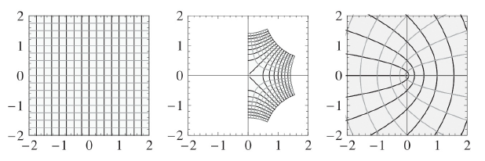
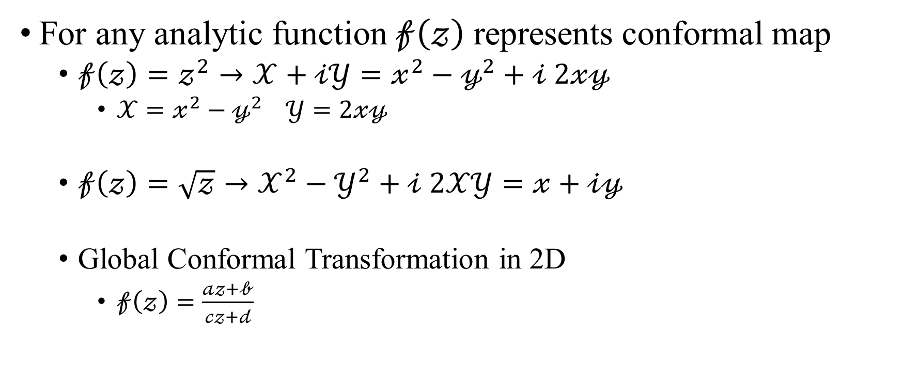
Conformal Transformation
For any analytic function $𝒻\left(𝓏\right)$ represents conformal map
$𝒻\left(𝓏\right)=𝓏^{2}→𝒳+𝒾𝒴=𝓍^{2}−𝓎^{2}+𝒾 2𝓍𝓎$
$𝒳=𝓍^{2}−𝓎^{2} 𝒴=2𝓍𝓎$
$𝒻\left(𝓏\right)=\sqrt{𝓏}→𝒳^{2}−𝒴^{2}+𝒾 2𝒳𝒴=𝓍+𝒾𝓎$
Global Conformal Transformation in 2D
$𝒻\left(𝓏\right)=\frac{𝒶𝓏+𝒷}{𝒸𝓏+𝒹}$

Slide 4
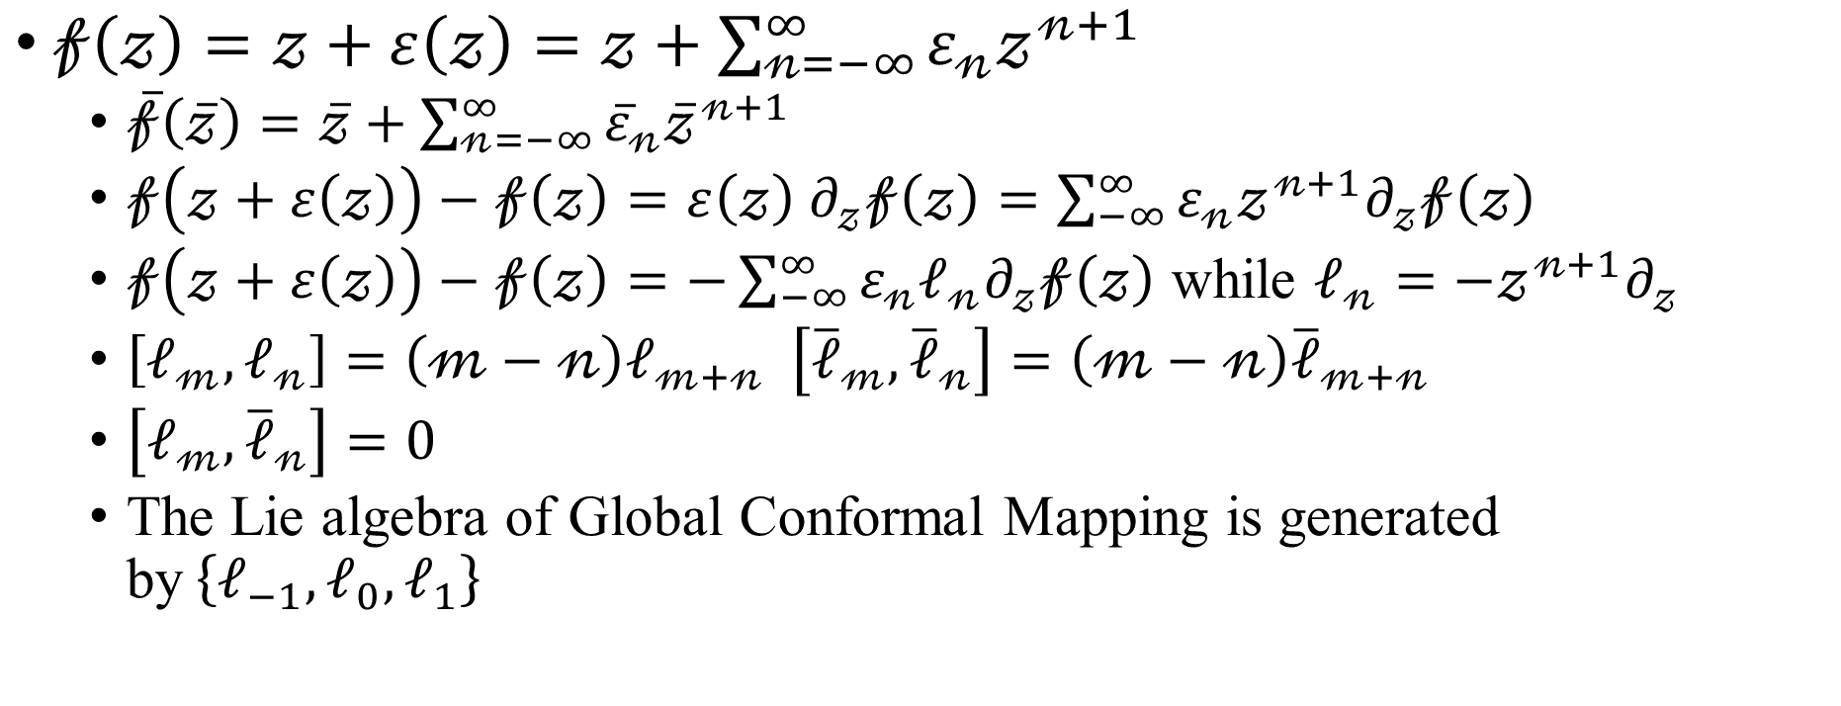
Conformal Transformation
$𝒻\left(𝓏\right)=𝓏+ε\left(𝓏\right)=𝓏+\sum_{𝓃=−∞}^{∞}{ε_{𝓃}𝓏^{𝓃+1}}$
$\overline{𝒻}\left(\overline{𝓏}\right)=\overline{𝓏}+\sum_{𝓃=−∞}^{∞}{{\overline{ε}}_{𝓃}{\overline{𝓏}}^{𝓃+1}}$
$𝒻\left(𝓏+ε\left(𝓏\right)\right)−𝒻\left(𝓏\right)=ε\left(𝓏\right) ∂_{𝓏}𝒻\left(𝓏\right)=\sum_{−∞}^{∞}{ε_{𝓃}𝓏^{𝓃+1}∂_{𝓏}𝒻\left(𝓏\right)}$
$𝒻\left(𝓏+ε\left(𝓏\right)\right)−𝒻\left(𝓏\right)=−\sum_{−∞}^{∞}{ε_{𝓃}ℓ_{𝓃}∂_{𝓏}𝒻\left(𝓏\right)}$ while $ℓ_{𝓃}=−𝓏^{𝓃+1}∂_{𝓏}$
$\left[ℓ_{𝓂},ℓ_{𝓃}\right]=\left(𝓂−𝓃\right)ℓ_{𝓂+𝓃} \left[{\overline{ℓ}}_{𝓂},{\overline{ℓ}}_{𝓃}\right]=\left(𝓂−𝓃\right){\overline{ℓ}}_{𝓂+𝓃}$
$\left[ℓ_{𝓂},{\overline{ℓ}}_{𝓃}\right]=0$
The Lie algebra of Global Conformal Mapping is generated by$\left\{ℓ_{−1},ℓ_{0},ℓ_{1}\right\}$

Slide 5
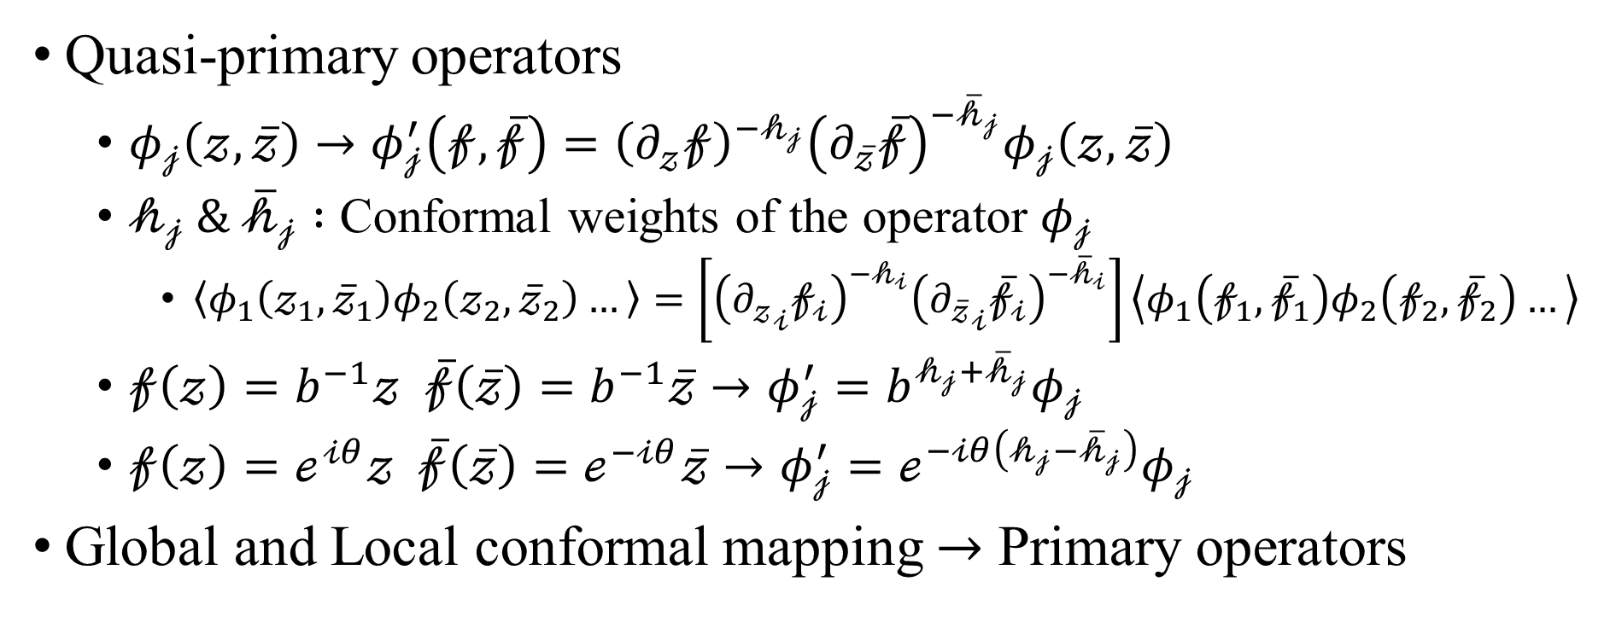
Primary and quasi-primary operators
Quasi-primary operators
$φ_{𝒿}\left(𝓏,\overline{𝓏}\right)→φ_{𝒿}^{′}\left(𝒻,\overline{𝒻}\right)={\left(∂_{𝓏}𝒻\right)}^{−𝒽_{𝒿}}{\left(∂_{\overline{𝓏}}\overline{𝒻}\right)}^{−{\overline{𝒽}}_{𝒿}}φ_{𝒿}\left(𝓏,\overline{𝓏}\right)$
$𝒽_{𝒿} \& {\overline{𝒽}}_{𝒿} :$ Conformal weights of the operator $φ_{𝒿}$
$\left\langle φ_{1}\left(𝓏_{1},{\overline{𝓏}}_{1}\right)φ_{2}\left(𝓏_{2},{\overline{𝓏}}_{2}\right)…\right\rangle =\left[{\left({∂_{𝓏}}_{𝒾}𝒻_{𝒾}\right)}^{−𝒽_{𝒾}}{\left({∂_{\overline{𝓏}}}_{𝒾}{\overline{𝒻}}_{𝒾}\right)}^{−{\overline{𝒽}}_{𝒾}}\right]\left\langle φ_{1}\left(𝒻_{1},{\overline{𝒻}}_{1}\right)φ_{2}\left(𝒻_{2},{\overline{𝒻}}_{2}\right)…\right\rangle$
$𝒻\left(𝓏\right)=b^{−1}𝓏 \overline{𝒻}\left(\overline{𝓏}\right)=b^{−1}\overline{𝓏}→φ_{𝒿}^{′}=b^{𝒽_{𝒿}+{\overline{𝒽}}_{𝒿}}φ_{𝒿}$
$𝒻\left(𝓏\right)=ℯ^{𝒾θ}𝓏 \overline{𝒻}\left(\overline{𝓏}\right)=ℯ^{−𝒾θ}\overline{𝓏}→φ_{𝒿}^{′}=ℯ^{−𝒾θ\left(𝒽_{𝒿}−{\overline{𝒽}}_{𝒿}\right)}φ_{𝒿}$
Global and Local conformal mapping $→$ Primary operators

Slide 6
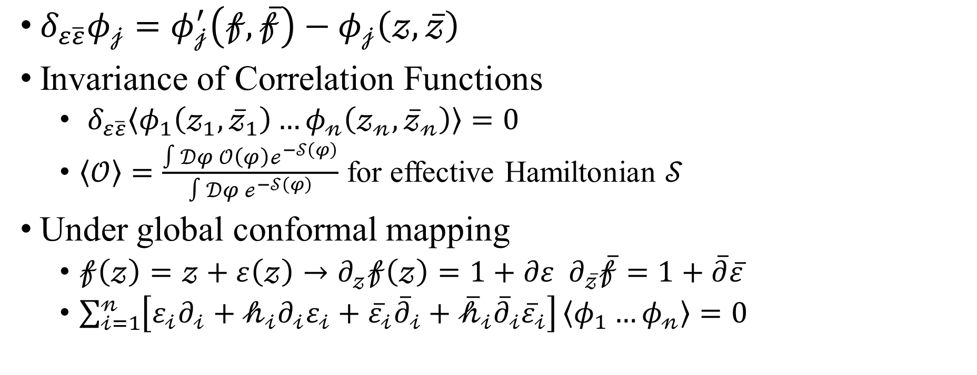
Invariance of correlation functions
$δ_{ε\overline{ε}}φ_{𝒿}=φ_{𝒿}^{′}\left(𝒻,\overline{𝒻}\right)−φ_{𝒿}\left(𝓏,\overline{𝓏}\right)$
Invariance of Correlation Functions
$δ_{ε\overline{ε}}\left\langle φ_{1}\left(𝓏_{1},{\overline{𝓏}}_{1}\right)…φ_{𝓃}\left(𝓏_{𝓃},{\overline{𝓏}}_{𝓃}\right)\right\rangle =0$
$\left\langle 𝒪\right\rangle =\frac{∫𝒟φ 𝒪\left(φ\right)ℯ^{−𝒮\left(φ\right)}}{∫𝒟φ ℯ^{−𝒮\left(φ\right)}}$ for effective Hamiltonian $𝒮$
Under global conformal mapping
$𝒻\left(𝓏\right)=𝓏+ε\left(𝓏\right)→∂_{𝓏}𝒻\left(𝓏\right)=1+∂ε ∂_{\overline{𝓏}}\overline{𝒻}=1+\overline{∂}\overline{ε}$
$\sum_{𝒾=1}^{𝓃}{\left[ε_{𝒾}∂_{𝒾}+𝒽_{𝒾}∂_{𝒾}ε_{𝒾}+{\overline{ε}}_{𝒾}{\overline{∂}}_{𝒾}+{\overline{𝒽}}_{𝒾}{\overline{∂}}_{𝒾}{\overline{ε}}_{𝒾}\right]}\left\langle φ_{1}…φ_{𝓃}\right\rangle =0$

Slide 7
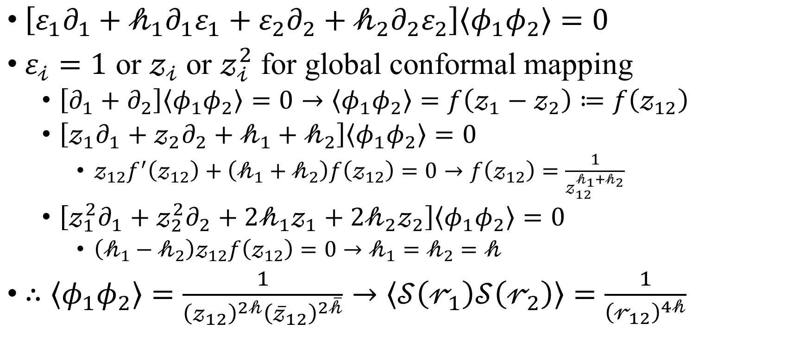
$\left[ε_{1}∂_{1}+𝒽_{1}∂_{1}ε_{1}+ε_{2}∂_{2}+𝒽_{2}∂_{2}ε_{2}\right]\left\langle φ_{1}φ_{2}\right\rangle =0$
$ε_{𝒾}=1$ or $𝓏_{𝒾}$ or $𝓏_{𝒾}^{2}$ for global conformal mapping
$\left[∂_{1}+∂_{2}\right]\left\langle φ_{1}φ_{2}\right\rangle =0→\left\langle φ_{1}φ_{2}\right\rangle =f\left(𝓏_{1}−𝓏_{2}\right)≔f\left(𝓏_{12}\right)$
$\left[𝓏_{1}∂_{1}+𝓏_{2}∂_{2}+𝒽_{1}+𝒽_{2}\right]\left\langle φ_{1}φ_{2}\right\rangle =0$
$𝓏_{12}f^{′}\left(𝓏_{12}\right)+\left(𝒽_{1}+𝒽_{2}\right)f\left(𝓏_{12}\right)=0→f\left(𝓏_{12}\right)=\frac{1}{𝓏_{12}^{𝒽_{1}+𝒽_{2}}}$
$\left[𝓏_{1}^{2}∂_{1}+𝓏_{2}^{2}∂_{2}+2𝒽_{1}𝓏_{1}+2𝒽_{2}𝓏_{2}\right]\left\langle φ_{1}φ_{2}\right\rangle =0$
$\left(𝒽_{1}−𝒽_{2}\right)𝓏_{12}f\left(𝓏_{12}\right)=0→𝒽_{1}=𝒽_{2}=𝒽$
$∴\left\langle φ_{1}φ_{2}\right\rangle =\frac{1}{{\left(𝓏_{12}\right)}^{2𝒽}{\left({\overline{𝓏}}_{12}\right)}^{2\overline{𝒽}}}→\left\langle 𝒮\left(𝓇_{1}\right)𝒮\left(𝓇_{2}\right)\right\rangle =\frac{1}{{\left(𝓇_{12}\right)}^{4𝒽}}$

Slide 8
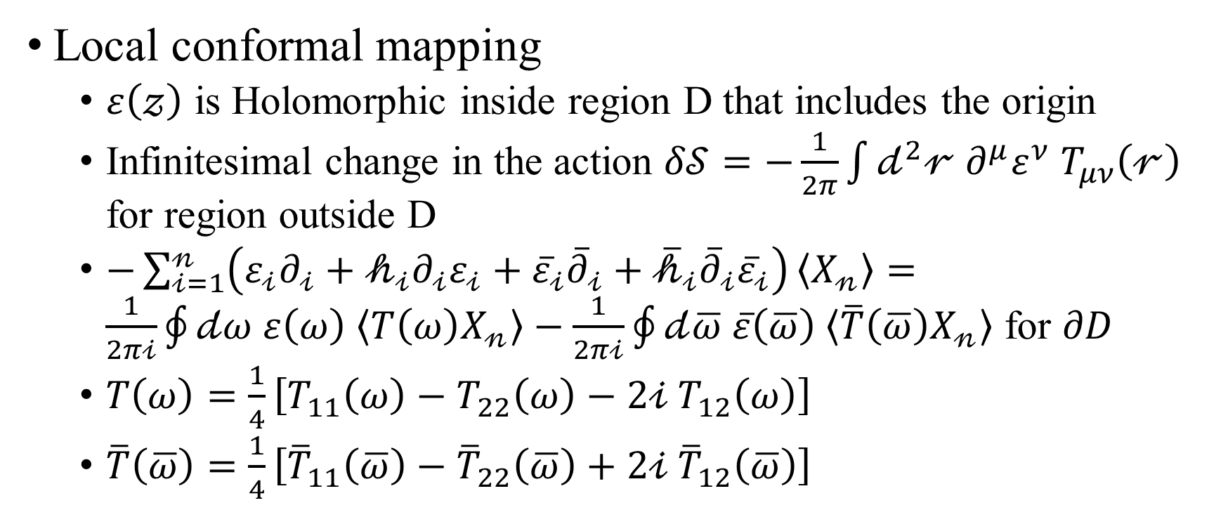
Local conformal mapping
$ε\left(𝓏\right)$ is Holomorphic inside region D that includes the origin
Infinitesimal change in the action $δ𝒮=−\frac{1}{2π}\int{𝒹^{2}𝓇 ∂^{μ}ε^{ν} T_{μν}\left(𝓇\right)}$ for region outside D
$−\sum_{𝒾=1}^{𝓃}{\left(ε_{𝒾}∂_{𝒾}+𝒽_{𝒾}∂_{𝒾}ε_{𝒾}+{\overline{ε}}_{𝒾}{\overline{∂}}_{𝒾}+{\overline{𝒽}}_{𝒾}{\overline{∂}}_{𝒾}{\overline{ε}}_{𝒾}\right)}\left\langle X_{𝓃}\right\rangle =\frac{1}{2π𝒾}\oint{𝒹ω ε\left(ω\right) \left\langle T\left(ω\right)X_{𝓃}\right\rangle }−\frac{1}{2π𝒾}\oint{𝒹\overline{ω} \overline{ε}\left(\overline{ω}\right) \left\langle \overline{T}\left(\overline{ω}\right)X_{𝓃}\right\rangle }$ for $∂D$
$T\left(ω\right)=\frac{1}{4}\left[T_{11}\left(ω\right)−T_{22}\left(ω\right)−2𝒾 T_{12}\left(ω\right)\right]$
$\overline{T}\left(\overline{ω}\right)=\frac{1}{4}\left[{\overline{T}}_{11}\left(\overline{ω}\right)−{\overline{T}}_{22}\left(\overline{ω}\right)+2𝒾 {\overline{T}}_{12}\left(\overline{ω}\right)\right]$

